Slide 1
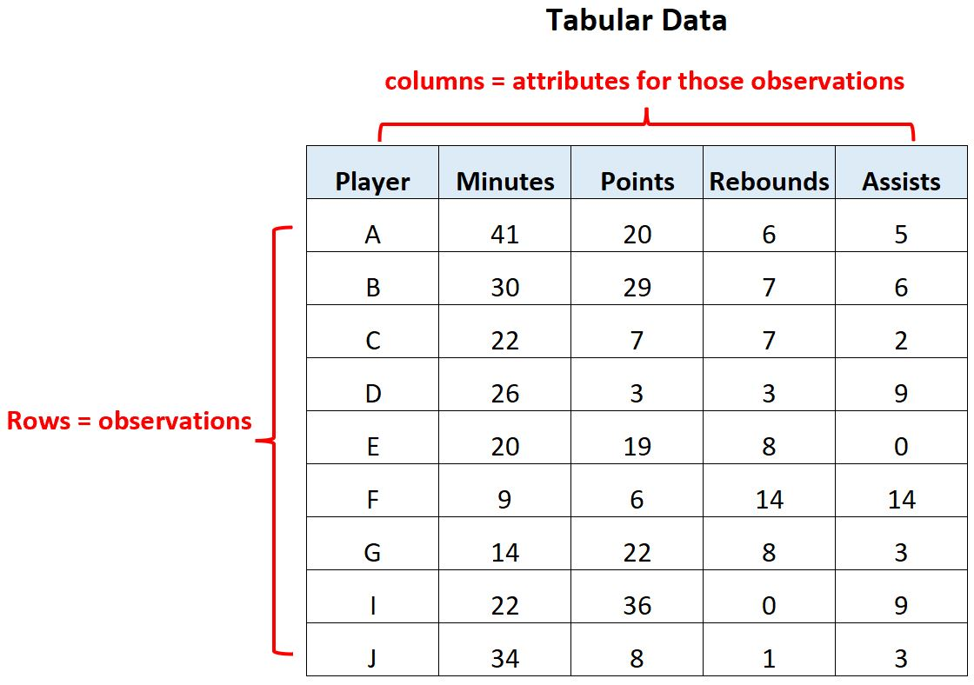
Handling Real-World Tabular Data
Dealing with Imbalance and Introduction to NLP
Instructor: Zaryab Ahmad Khan

Slide 2
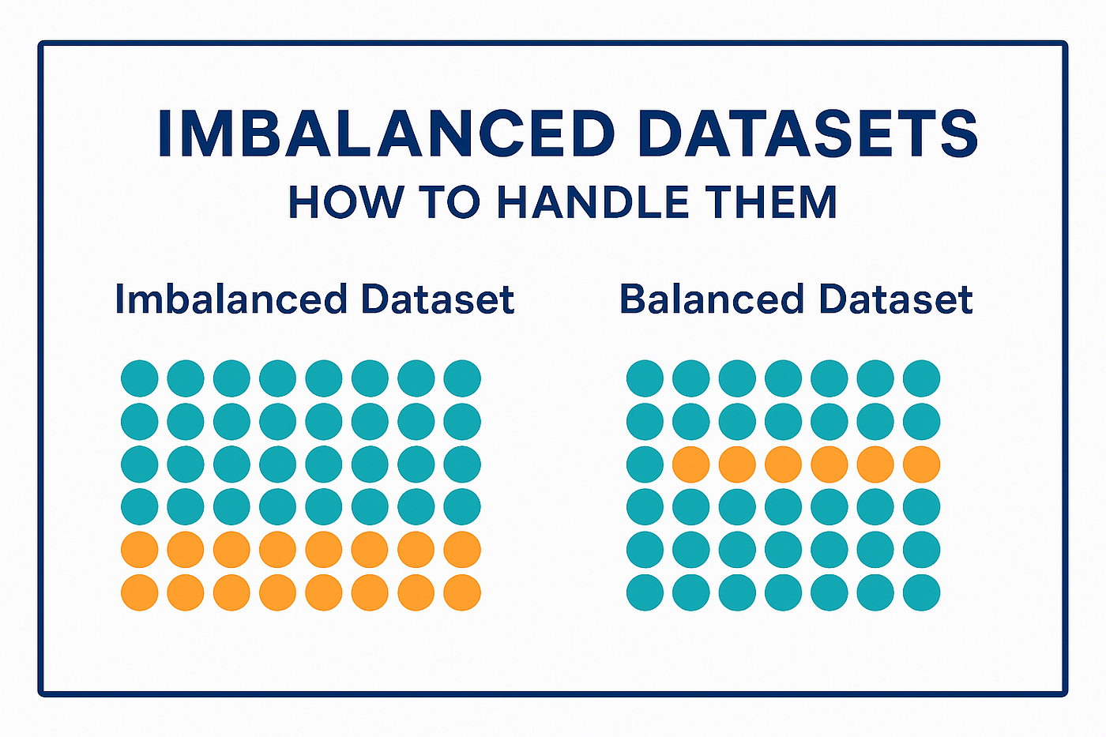
Imbalanced Datasets (The 99% Problem)
The Problem: In many real-world scenarios, one category is massive and the other is tiny.
Example: If 99% of bank transactions are "Safe" and only 1% are "Fraud," an AI can get 99% accuracy just by guessing "Safe" every time.
The Danger: The model becomes "lazy" and ignores the rare, but important, minority class.

Slide 3
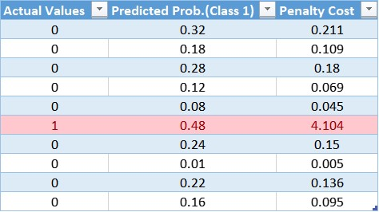
Class Weights (The Balancing Act)
The Solution: We tell the algorithm that the minority class is more important.
How it works: We assign a higher "weight" to the rare class.
Effect: The model gets "punished" more heavily for missing a minority case, forcing it to pay closer attention to those tiny patterns.

Slide 4
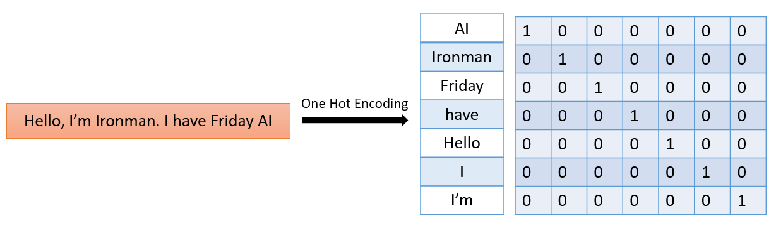
Basic NLP (Turning Words into Numbers)
The Problem: AI models are math engines; they cannot process a paragraph of text directly.
The Solution: CountVectorizer.
Process: It counts how many times each word appears in a sentence and turns that sentence into a row of numbers.
Use Case: Turning customer reviews or emails into data that a standard model (like Logistic Regression) can read.

